Slide 1
The Magnus Effect
Flow Around a Rotating Sphere

Slide 2
Contents
Model Definition
Laminar Flow
The influence of spin
Analogy with cylinder: 2D
Steady and unsteady flow
Turbulent Flow
Laminar and turbulent boundary layer and the soccer ball
Concluding remarks

Slide 3
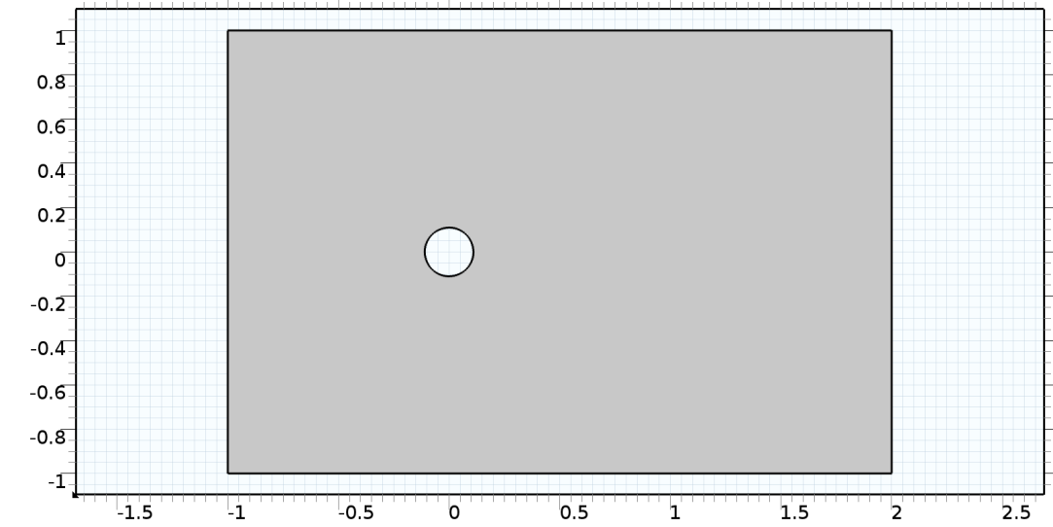
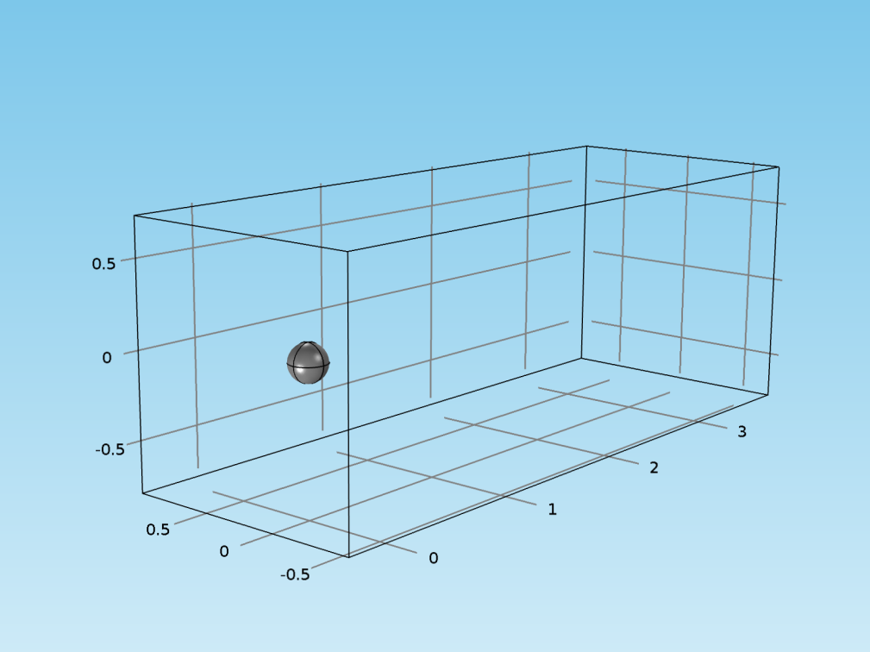
Model Definition
2D case, cylinder
Upper and lower boundary conditions:
Open or analytic solution for potential flow
Cylinder boundary:
Rotating sliding wall
3D case, sphere
Top, bottom, and side boundary conditions:
Open
Sphere boundary:
Rotating sliding wall
Air
Inlet
Outlet
Direction of
cylinder rotation
Air
Outlet
Direction of
Sphere rotation
Inlet

Slide 4
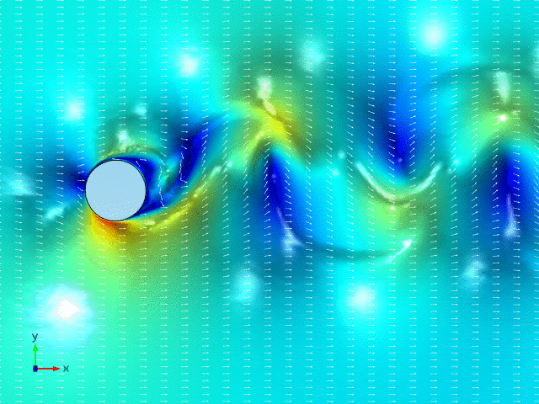
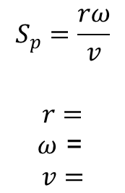
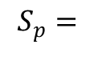
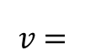
Laminar Flow: The Influence of Spin
2D cylinder, laminar flow
$$\begin{matrix} \\ v=\end{matrix}$$
1 (m/s)
$$\begin{matrix}S_{p}= \\ \end{matrix}$$
1 (dim. less)
$$\begin{matrix}S_{p}=\frac{rω}{v} \\ \\ r= \\ ω\text{ = } \\ v=\end{matrix}$$
Spin
No stationary solution found!
Radius
Angular velocity
Flow velocity or velocity of a moving cylinder
at the center

Slide 5
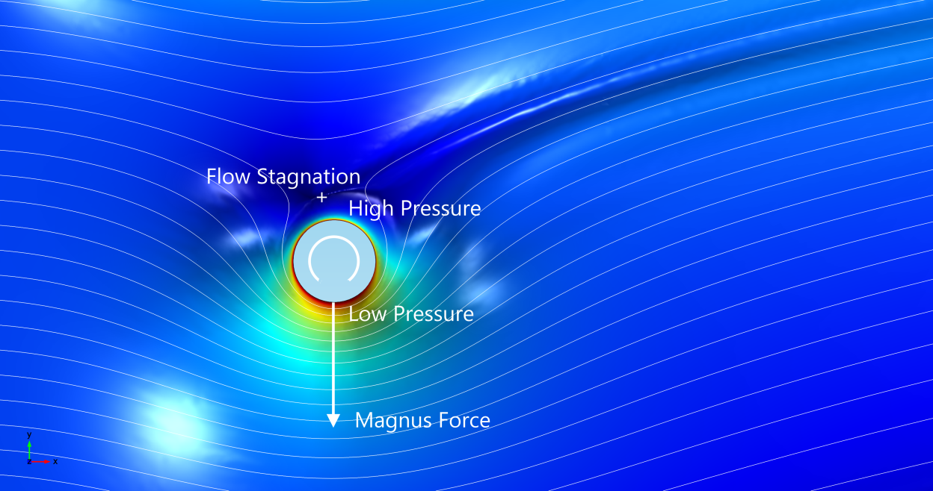
Laminar Flow: The Influence of Spin
2D cylinder, laminar flow
Boundary conditions, top and bottom, obtained from the analytical solution for potential flow
$$\begin{matrix} \\ v=\end{matrix}$$
1 (m/s)
$$\begin{matrix}S_{p}= \\ \end{matrix}$$
5 (dim. less)
Higher spin yields stationary solution

Slide 6
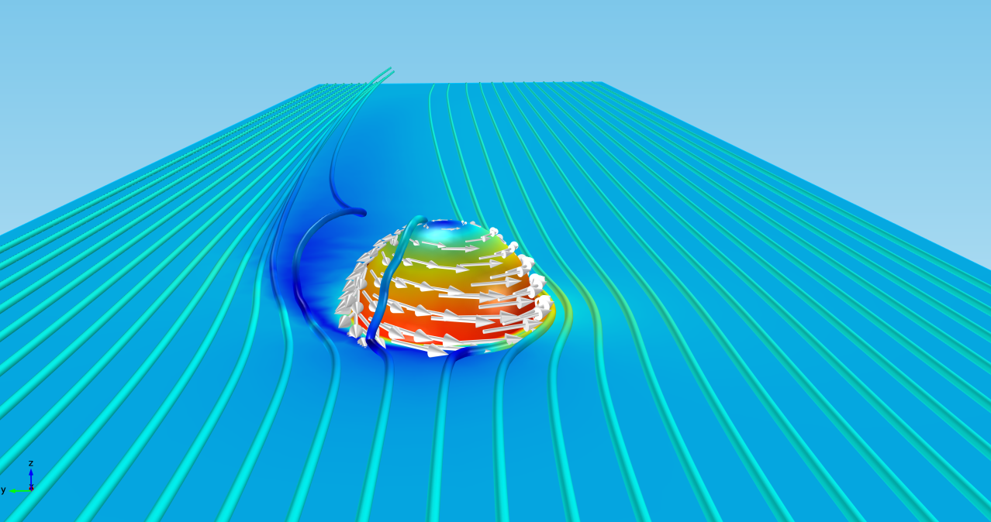
Laminar Flow: The Influence of Spin
3D sphere, laminar flow
The rotational velocity at the surface of the ball decreases from the equator to the poles: No stationary solution
$$\begin{matrix} \\ v=\end{matrix}$$
1 (m/s)
$$\begin{matrix}S_{p}= \\ \end{matrix}$$
5 (dim. less)
Low velocity,
High Pressure
High velocity,
Low Pressure
Magnus Force, F_{L}

Slide 7

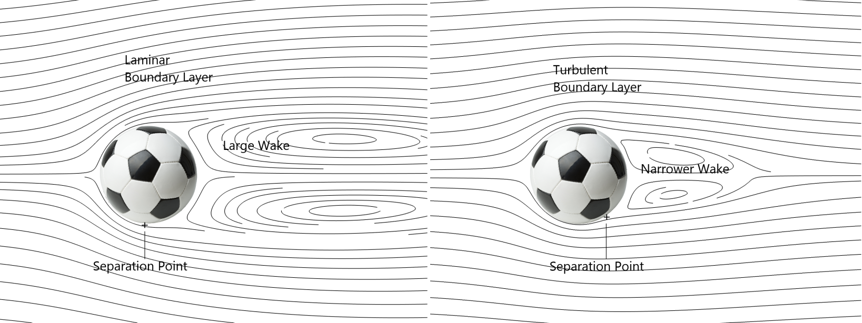
Turbulent Flow
In the case of turbulent flow, we can have laminar or turbulent boundary layers:
Example soccer ball: Large wake causes large drag

Slide 8
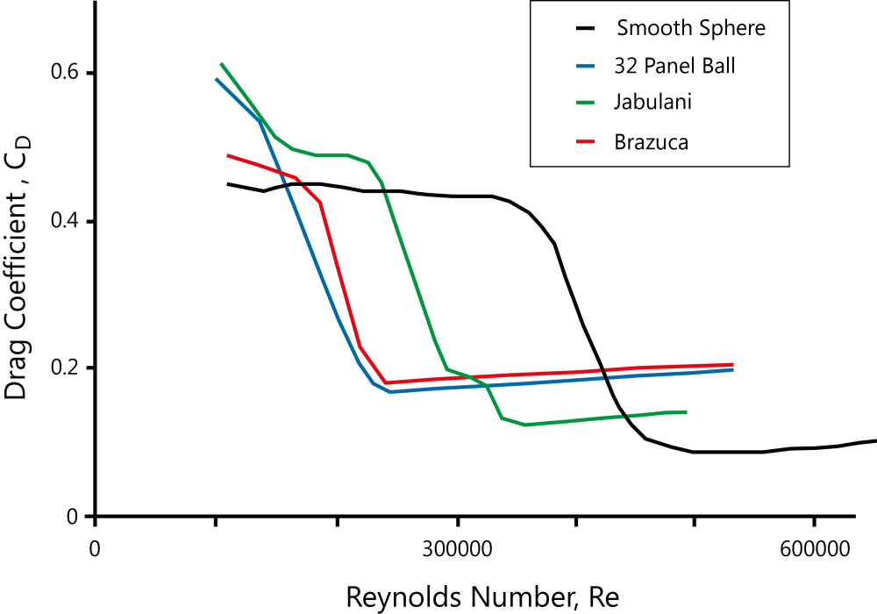
Turbulent Flow: Adidas® World CupTM Ball
Measurements of drag with no spin: http://www.nature.com/srep/2014/140529/srep05068/full/srep05068.html
Laminar Boundary Layer
Turbulent Boundary Layer

Slide 9
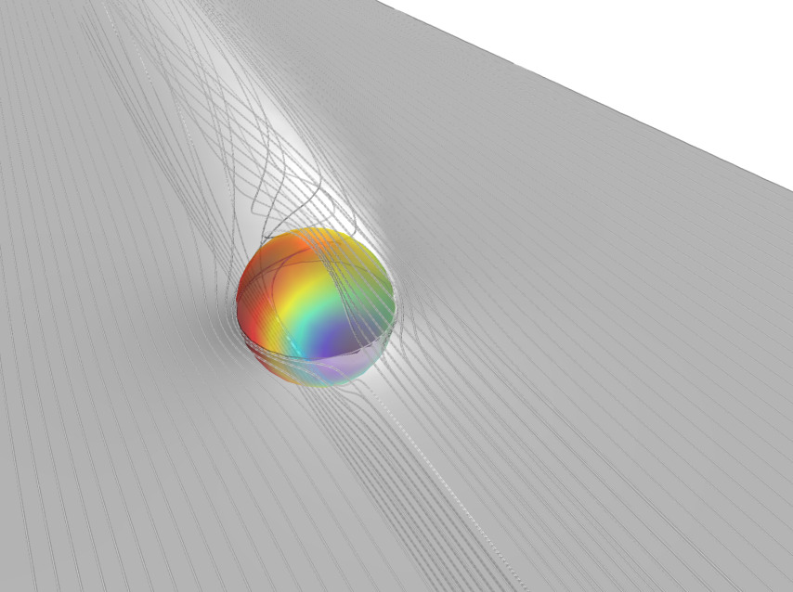
Turbulent Flow and Turbulent Boundary Layer
3D sphere
Turbulence model: k-ε model
Wall functions and rough surface to mimic a soccer ball
$$\begin{matrix} \\ v=\end{matrix}$$
5 (m/s)
$$\begin{matrix}S_{p}= \\ \end{matrix}$$
1 (dim. less)
Normal stress on the ball’s surface
Low velocity,
High Pressure
High velocity,
Low Pressure
Magnus Force, F_{L}
Magnus Force, F_{L}

Slide 10
Concluding Remarks
Accurate model requires the description of the transition of the flow from laminar to turbulent, and vice versa, in the boundary layer:
Transition models may work
The geometry of the seams has an influence on both transition and drag and has to be accounted for in accurate models
However, experiments on the soccer field show that curling the ball has a stabilizing effect on its flight

Slide 11
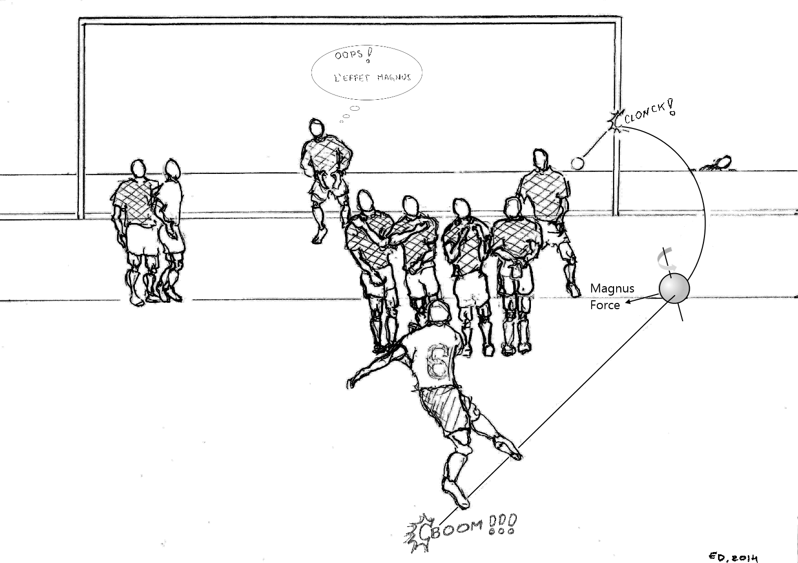
Enjoy The Magnus Effect!
http://www.youtube.com/watch?v=rEKGTq3onIo

